Slide 1
HackYourFuture
Databases - Lesson 1
Class 4
07/07/2019
Borja Romero Gina Stavropoulou (Geert Van Pamel)
Lessons 1,2,3 Lessons 1,2 Lessons 2,3

Slide 2


Who is who?
Borja Romero
Gina Stavropoulou
Spanish
In Belgium since 2007
Working for the European Institutions
Building a data warehouse for Agricultural products
Real Madrid supporter
Greek
In Belgium since 2014
Working for the Kapernikov
Working mostly with LiDAR data in computer vision projects
Film fanatic
Notes:
Who knows what data warehouse is?
Who knows a Real Madrid player?
where are we working/ 1st time we are teaching
Labels with names
Recording the presentation

Slide 3
Goals
By the end of this module, you should be familiar with the following:
Entities & Fields
The relational database model
The Structured Query Language (SQL)
The construction of a database system
MySQL as an example of a relational database system

Slide 4
Course Overview
Week 1 (7/7): Introduction, Relational Databases, Entity Relationship Diagram (ERD), Basic SQL commands
Objective: In the first part of the class we will explain what a relational database is. We will look into Entity Relationship Diagrams and we will get you started with MySQL. By the end of this class you should be able to perform basic queries in a database and create your own tables.
Week 2 (14/7): Group by, Distinct, Having, Inner & Outer Joins
Objective: This class introduces more clauses (group by, having) in the select statement. MySQL joins (inner, self, left and right) should be explained with demonstration.
Week 3 (21/7): Database design, Normal Forms, SQL injection, NoSQL
Objective: In this class we will discuss again the Entity Relationship Diagram (ERD). Students should be able to explain their choices of entities, relationships, attributes etc. SQL injection should be explained with a demonstration (with a simple JS client). Concepts of database transaction, ACID properties, normal forms should be introduced with examples. Small introduction to NoSQL and revision of the material is also planned.

Slide 5
What is a database?
A collection of (organised) information
Oxford dictionary:
“A structured set of data held in a computer, especially one that is accessible in various ways.
‘a database covering nine million workers’
Oracle, MySql, Postgres are Database Management Systems :)
They are in your phone, in your laptop, spread across multiple servers.
Notes:
What about now? Could we call a Javascript const a database? A CSV file? An Excel?

Slide 6
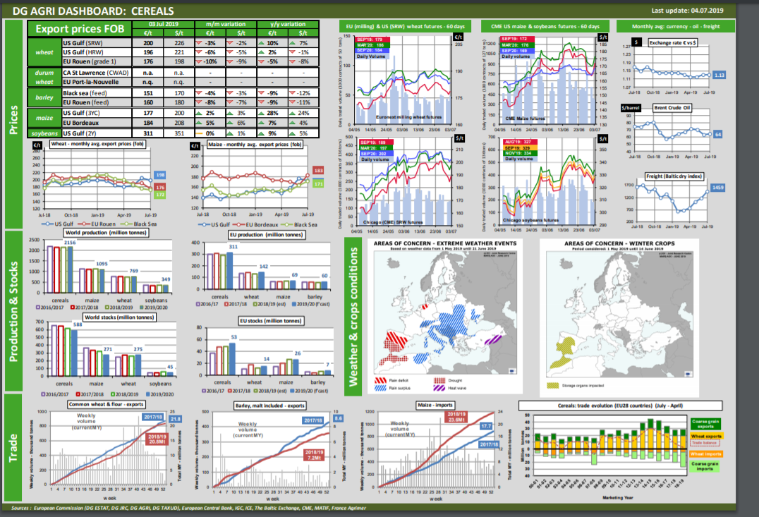
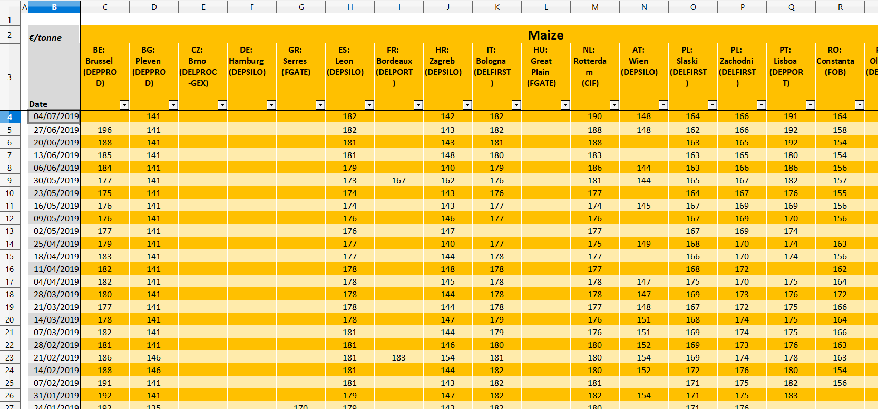
Spreadsheets: World’s favourite “database”
What if we told you that this?
...comes from 20 files like this?
Notes:
For me Excel fulfils the Oxford definition of database.

Slide 7
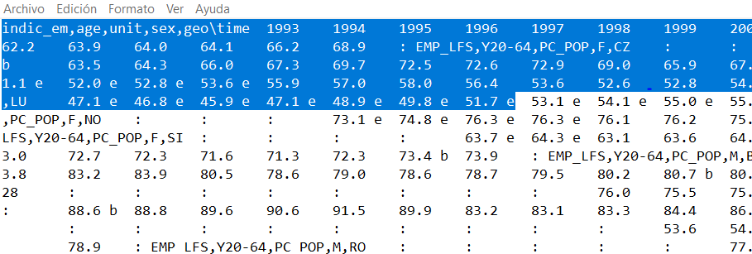
Other “databases”
Javascript
JSON
const musicians = [
"John Coltrane",
"Miles David",
"Thelonious Monk",
"Sonny Rollins"];
Storing new information:
musicians.push("Steve Lehman");
Information access:
console.log(musicians[0]);
[
{"name":"Ram", "email":"Ram@gmail.com"},
{"name":"Bob", "email":"bob32@gmail.com"}
]
TSV ( Eurostat)

Slide 8
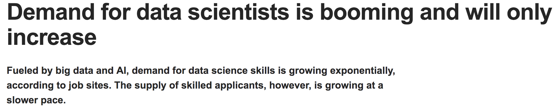
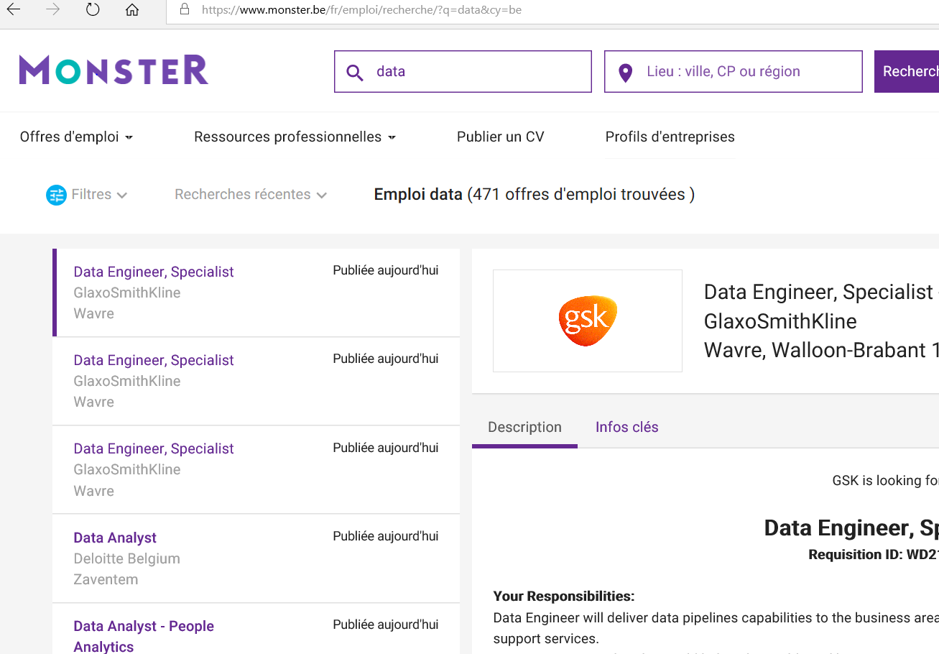

So… why bother?

Slide 9
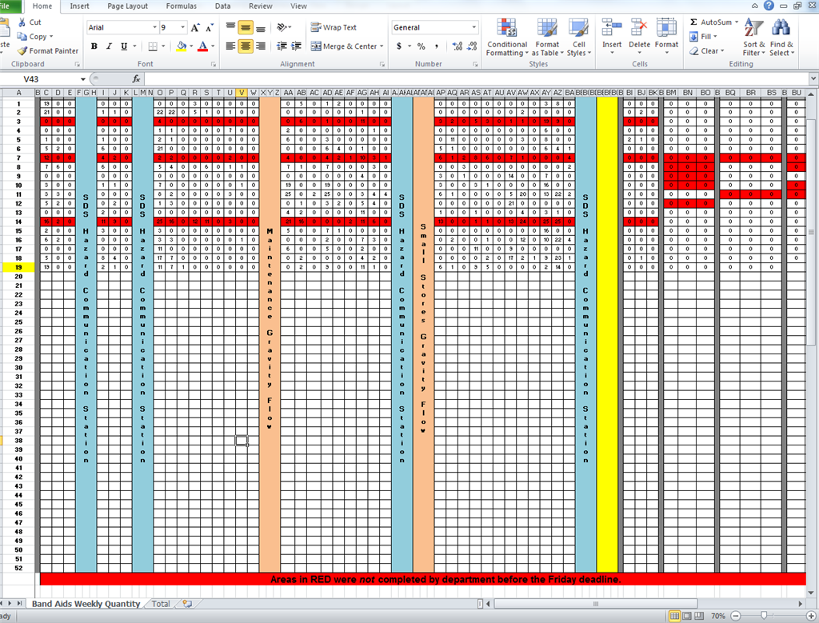
Ok, you convinced me but I already know Excel…
… and JSON, CSV files do not look so complex either…”
What were your limitations?
Size
Ease of update
Collaboration
Accuracy
Security
Redundancy (backups)
Mix of code and data
Notes:
Excel : 1 million rows,
255 char limitation per column
32,767 characters per cell.
Data and logic is together: modifying implies copies, multiples copies leads to chaos.
Media?

Slide 10
Relational Databases
A relational database stores information in tables consisting of rows and columns; the columns (fields/attributes) are the properties of the item and the rows (records, tuples) represent individual items
Users Table
ID | Name | Last Name | email
got1 | Daenerys | Targaryen | danny@gotmail.com
got2 | John | Snow | john@gotmail.com
got3 | Tyrion | Lannister | tyrion@gotmail.com
got4 | Arya | Stark | arya@gotmail.com
Notes:
let;s imagine we have an online shop
i added the fields/attributes and records to let them know that they can find people refering to the same with different names

Slide 11
Relational Databases
Products Table
ID | Product Name
prd1 | Valyrian Steel
prd2 | Arrows
prd3 | Dog food
Customers Table
ID | Name | Last Name | email
got1 | Daenerys | Targaryen | danny@gotmail.com
got2 | John | Snow | john@gotmail.com
got3 | Tyrion | Lannister | tyrion@gotmail.com
got4 | Arya | Stark | arya@gotmail.com
Orders Table
ID | Customer_ID | Product_ID
ord1 | got2 | prd3
ord2 | got2 | prd1
ord3 | got4 | prd2
Notes:
It is good to have your data in seperate tables and organised nicely instead of throwing everything in one table.

Slide 12
Relational Databases
Why not everything in one table?
Customers_and_Orders Table
Name | Last Name | email | Product
Daenerys | Targaryen | danny@gotmail.com | Arrows
John | Snow | john@gotmail.com | Arrows
John | Snow | john@gotmail.com | Dog Food
We want to avoid data redundancy
Notes:
It is good to have your data in seperate tables and organised nicely instead of throwing everything in one table.

Slide 13
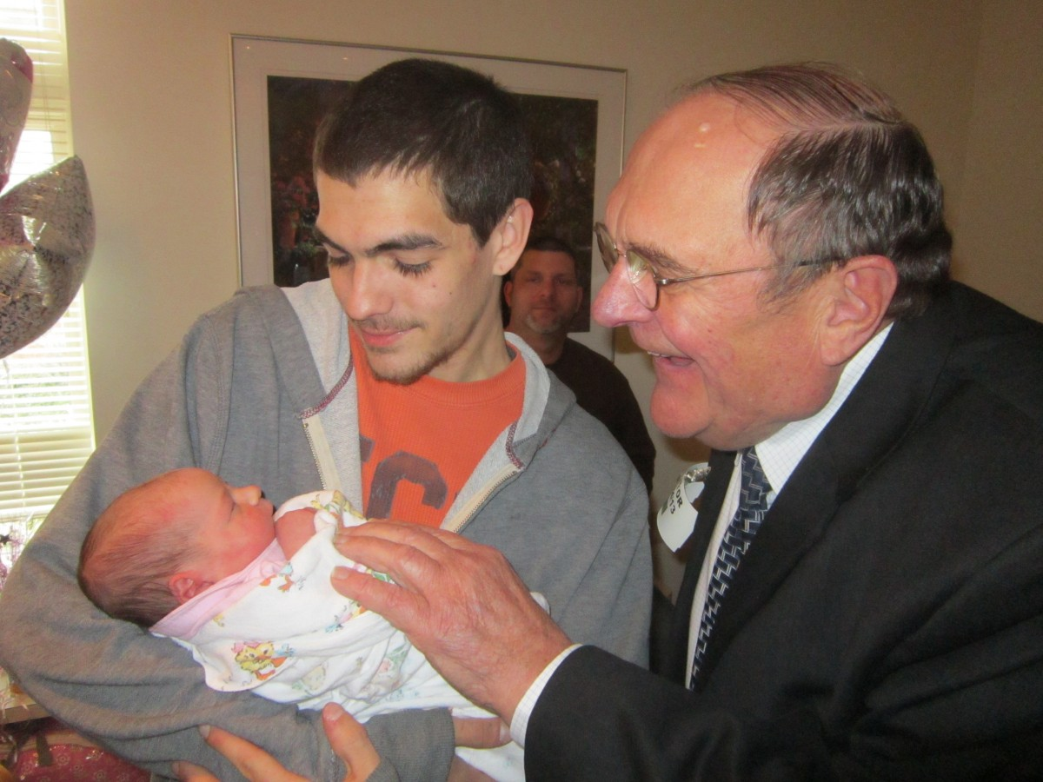
Identifying a record

Slide 14
Primary Key
A unique identifier: Cannot be repeated in the database.
ID | Name | Last Name | email
1 | Walder | Frey | walder19@gmail.com
2 | Walder | Frey | wfrey@gmail.com
3 | Walder | Frey | walderfrey@gmail.com
4 | Walder | Frey | wfrey91@gmail.com
Notes:
whenever a new user signs up to our website we give them a new id number.

Slide 15
Primary Key
A unique identifier: Cannot be repeated in the database.
ID | Name | Last Name | email
got1 | Daenerys | Targaryen | danny@gotmail.com
got2 | John | Snow | john@gotmail.com
got3 | Tyrion | Lannister | tyrion@gotmail.com
got4 | Arya | Stark | arya@gotmail.com

Slide 16
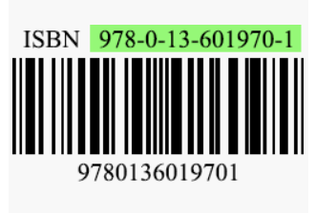
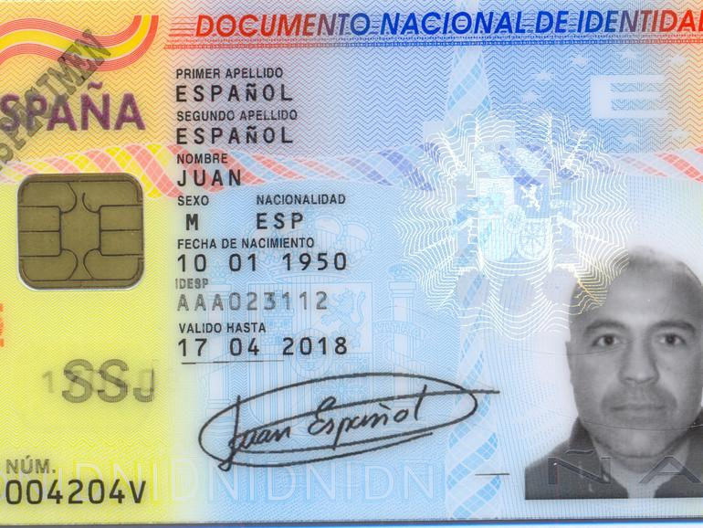


Real Life (™) Primary keys

Slide 17
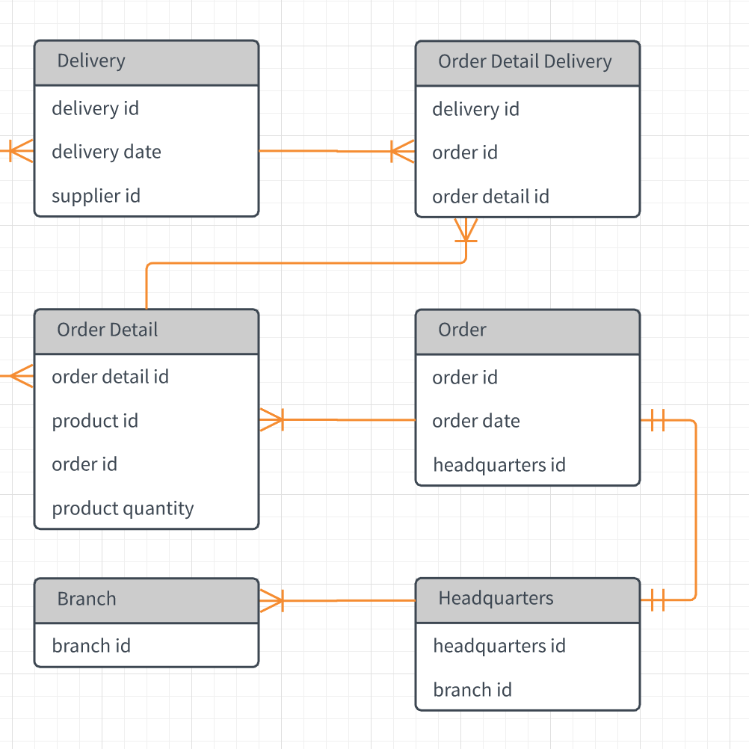
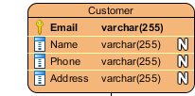
Entity Relationship Diagram
Helps to understand how the different element of the database interact with each other
Entity
Fields
Relationships:
one-to-one
one-to-many
many-to-many
Tools: Lucidchart, draw.io, MS Visio ($$), Enterprise Architect ($$$), a piece of paper ;)
Notes:
Entities are objects or concepts that represent important data. Entities are typically nouns such as product, customer, location, or promotion. There are three types of entities commonly used in entity relationship diagrams
Fields represent the portion of a table that establish the attributes of the entity. Attributes are typically thought of as columns in the database that the ERD models.

Slide 18
Lucidchart
Enough of slides PLEEEEASE!
LET’s START PLAYING
https://www.lucidchart.com

Slide 19
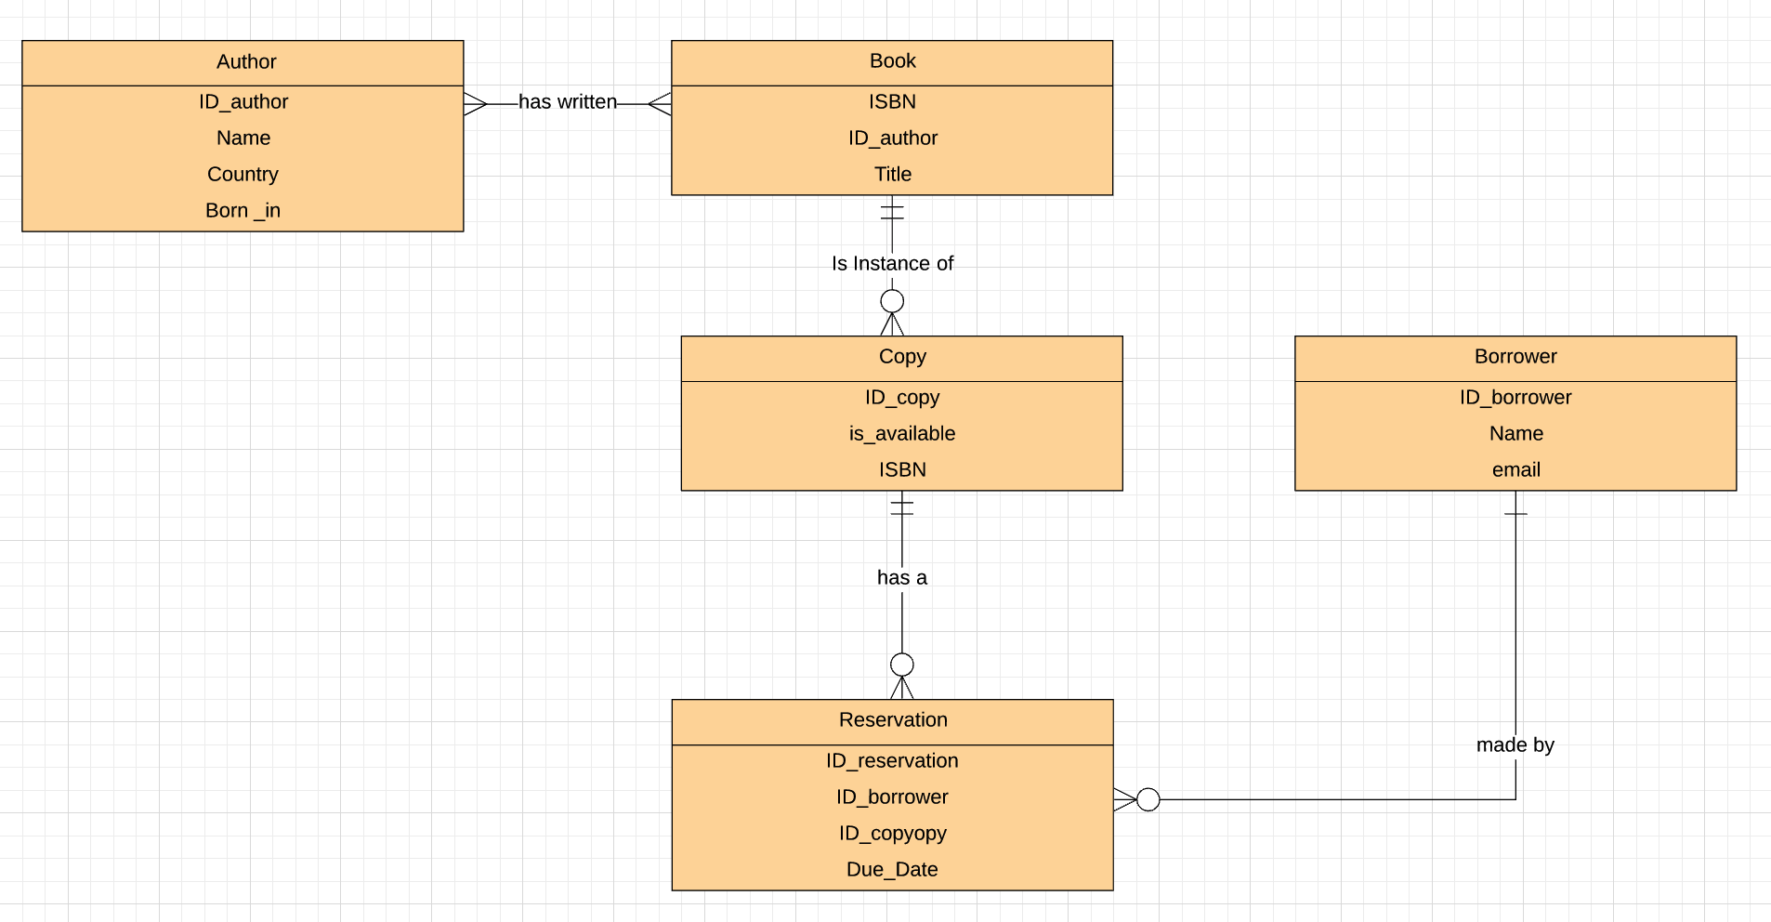
Lucidchart (Solution)

Slide 20
Getting Started
Install MySQL using the following official docs
(MAC users may use brew install mysql)
Download some sample libraries from here.
Put them in a folder in your desktop.
Open a terminal and connect to mysql:
mysql -u root
Load the sample databases:
SOURCE /path/to/the/databases/folder/imdb.sql
SOURCE /path/to/the/databases/folder/world.sql
SOURCE /path/to/the/databases/folder/musicians.sql
Notes:
Mac:
brew update
brew install mysql
(mysqld)
mysql -uroot
SOURCE /path/to/the/databases/folder/musicians.sql

Slide 21

Break time!

Slide 22

What is SQL?
Structured Query Language
A language used to pull(query) data out of a database.

Slide 23

SQL differences
And SQL language

Slide 24

MySQL
One of the first open source databases, developed in the 90’s
A Relational Database Management System (RDBMS)
Uses SQL
Allows data handling, storing, modifying, deleting in a form of tables.

Slide 25
Data Modeling (DDL vs DML)
DDL Data Definition Language
CREATE
DROP
DESC
TRUNCATE
ALTER
DML Data Manipulation Language
SELECT
INSERT
UPDATE
DELETE

Slide 26
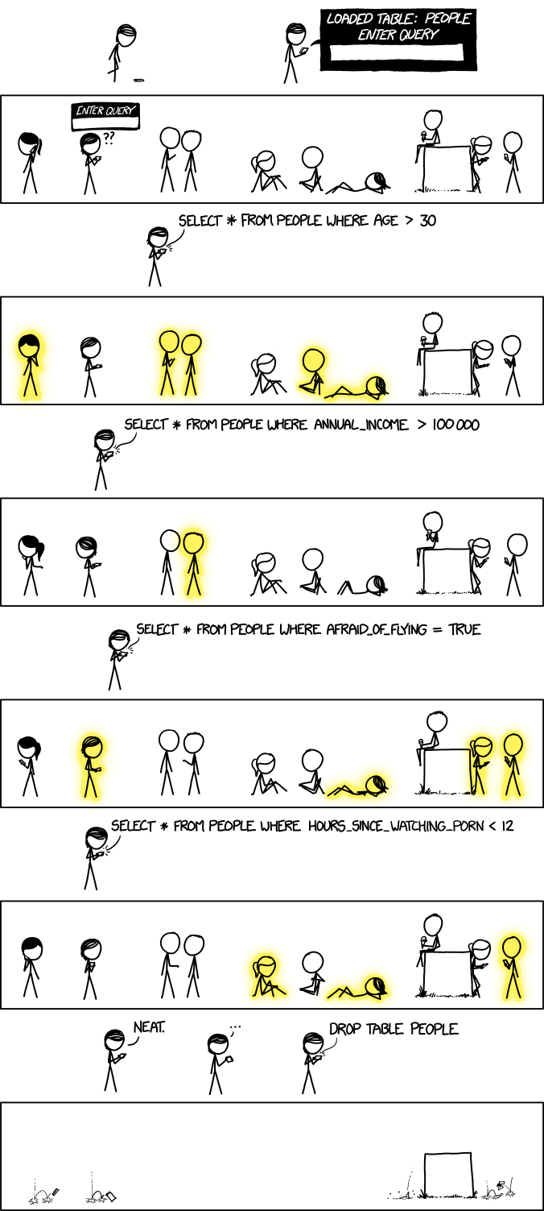
SELECT

Slide 27
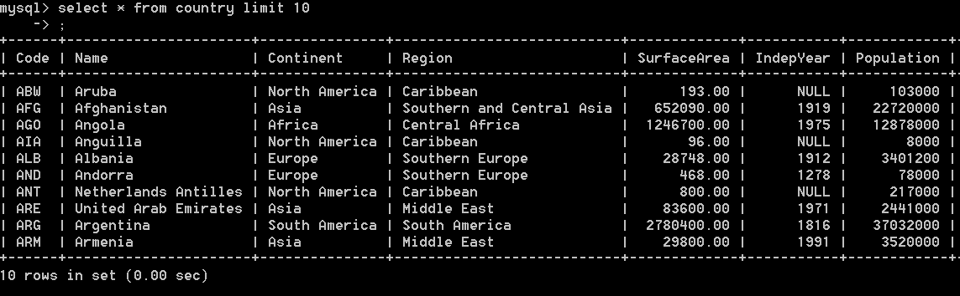
SELECT
How does a select look like?

Slide 28
SELECT
SELECT column1, column2, …
FROM table1;
SELECT FirstName
FROM Musicians;
+------------+
| FirstName |
+------------+
| Thelonious |
| Sonny |
| Steve |
+------------+
3 rows in set (0.00 sec)
SELECT *
FROM table1;

Slide 29
SELECT … WHERE...
SELECT column1, column2, …
FROM table1;
SELECT column1, column2, …
FROM table1
WHERE condition
AND/OR another_condition
AND/OR …;
SELECT FirstName
FROM Musicians;
+------------+
| FirstName |
+------------+
| Thelonious |
| Sonny |
| Steve |
+------------+
3 rows in set (0.00 sec)
SELECT *
FROM Musicians
WHERE FirstName = 'Thelonious'
+----+------------+----------+------+
| Id | FirstName | LastName | Born |
+----+------------+----------+------+
| 1 | Thelonious | Monk | 1917 |
+----+------------+----------+------+
1 row in set (0.00 sec)
SELECT *
FROM table1;

Slide 30
SELECT (Operators, BETWEEN, IN, NOT IN)
Operator | Condition | SQL Example
=, !=, < <=, >, >= | Standard numerical operators | col_name != 4, col_name = “abc”
BETWEEN … AND … | Number is within range of two values (inclusive) | col_name BETWEEN 1.5 AND 10.5
NOT BETWEEN … AND … | Number is not within range of two values (inclusive) | col_name NOT BETWEEN 1 AND 10
IN (…) | Number or string exists in a list | col_name IN (2, 4, 6), col_name IN (“a”, “b”)
NOT IN (…) | Number or string does not exist in a list | col_name NOT IN (1, 3, 5), col_name NOT IN (“a”, “b”)
Source: SQLBolt

Slide 31
SELECT (Exercise time!)
Switch to the imdb database.
See which tables it includes.
Try to answer the following queries:
Find all the first and last name of all the actors.
Find the first name of the actor with ID = 3.
Find all the actors whose name is “Jennifer”.
Find the name and biographies of all the actresses.
Find the first and last name of the actor whose age is above 50.
Find the titles of the films with ratings between 6 and 8.
Find the titles and the ratings of the films that were NOT released between 1990 and 2000.

Slide 32
SELECT (Solutions)
Find all the first and last name of all the actors.
select fname, lname from actors;
Find the first name of the actor with ID = 3.
select fname from actors where aid=3;
Find all the actors whose name is “Jennifer”.
select fname, lname from actors where fname = "Jennifer";
Find the last name and biographies of all the actresses.
select lname, biography from actors where gender="f";

Slide 33
SELECT (Solutions)
5. Find the first and last name of the actor whose age is above 50.
select fname, lname from actors where age>50;
6. Find the titles and ratings of the films with ratings between 6 and 8.
select mname, rating from films where rating between 6 and 8;
7. Find the titles and year of the films that were NOT released between 1990 and 2000.
select mname, rating from films where year not between 1990 and 2000;

Slide 34
SELECT (LIKE, ORDER BY, LIMIT, COUNT)
Operator | Condition | Example
LIKE | Case insensitive exact string comparison | col_name LIKE "abc"
NOT LIKE | Case insensitive exact string inequality comparison | col_name NOT LIKE "abc"
% | Used anywhere in a string to match a sequence of zero or more characters (only with LIKE or NOT LIKE) | col_name LIKE "%TO%" (results in "TOMATO", "POTATO", "TO","TOP")
Source: SQLBolt
SELECT column1,column2, …
FROM table1
WHERE condition(s)
ORDER BY column ASC (or DESC);
SELECT column1,column2, …
FROM table1
WHERE condition(s)
ORDER BY column ASC (or DESC)
LIMIT number_of_results;
SELECT COUNT(*) FROM table1;

Slide 35
SELECT (Exercise time!)
Now try these queries:
Find all the information about the actors whose first name starts with an A.
Find all the movie titles that contain the word “club”.
Find all the films that do not contain the word “games”.
Find all the film title and ratings in descending order of rating.
Find all the information about the 3 films.
Find the titles of the 3 most recent films.
Count all the films in the database.

Slide 36
SELECT (Exercise time!)
Find all the information about the actors whose first name starts with an A.
select * from actors where fname like "A%";
Find all the movie titles that contain the word “club”.
select title from films where title like "%club%";
Find all the films that do not contain the word “games”.
select title from films where title not like "%games%”;
Find all the film title and ratings in descending order of rating.
select title, rating from films order by rating desc;

Slide 37
SELECT (Exercise time!)
Now try these queries:
5. Find all the information about 3 films only.
select * from films limit 3;
6. Find the titles of the 3 most recent films.
select mname from films order by year desc limit 3;
7. Count all the films in the database.
select count(*) from films;

Slide 38
SELECT SYNTAX
(OMG!) How to read a statement syntax:
SELECT [ALL | DISTINCT | DISTINCTROW ]
[HIGH_PRIORITY] [STRAIGHT_JOIN][SQL_NO_CACHE] [SQL_CALC_FOUND_ROWS]
select_expr [, select_expr ...]
[FROM table_references
[PARTITION partition_list]
[WHERE where_condition]
[GROUP BY {col_name | expr | position}, ... [WITH ROLLUP]]
[HAVING where_condition]
[ORDER BY {col_name | expr | position} [ASC | DESC], ...]
[LIMIT {[offset,] row_count | row_count OFFSET offset}]

Slide 39
CREATE
CREATE DATABASE db_name;
CREATE TABLE table1 [IF NOT EXISTS] (
column1_name data_type [NOT NULL] [DEFAULT default_value],
column2_name data_type,…, PRIMARY KEY (column2_name);
CONSTRAINTS:
The NOT NULL indicates that the inserted value cannot be NULL.
The DEFAULT value is used to specify the default value of the column.
The PRIMARY KEY specifies that values are the unique identifiers.

Slide 40
CREATE
Each column has a name and a data type. For some data types you can also specify a maximum length
Data type
INTEGER, BOOLEAN
FLOAT, DOUBLE, REAL
CHARACTER(max_length), VARCHAR(max_length), TEXT
DATE, DATETIME
EXAMPLE:
CREATE TABLE `actors` (
`aid` int(11) NOT NULL AUTO_INCREMENT,
`fname` varchar(50) DEFAULT NULL,
`lname` varchar(50) DEFAULT NULL,
`biography` text,
`age` int(2) DEFAULT NULL,
`sex` varchar(1) DEFAULT NULL,
PRIMARY KEY (`aid`)) ;
More data types: https://dev.mysql.com/doc/refman/8.0/en/data-types.html

Slide 41
CREATE (Exercise time!)
Create a database named “class4”.
Create a table “students”. We would like to store first and last name, email, country, age and height. Each student should also have an unique identifier. First and last name should always be inserted.

Slide 42
CREATE (Solution)
create database class4;
create table students(fname varchar(50) not null, lname varchar(50) not null, email text, country varchar(50), height float, age integer default 0, id int, primary key(id));

Slide 43
CREATE SYNTAX
CREATE [TEMPORARY] TABLE [IF NOT EXISTS] tbl_name
(create_definition,...)
[table_options]
[partition_options]
create_definition:
col_name column_definition
| {INDEX|KEY} [index_name] [index_type] (key_part,...)
[index_option] ...
| [CONSTRAINT [symbol]] PRIMARY KEY
[index_type] (key_part,...)
[index_option] ...
| [CONSTRAINT [symbol]] UNIQUE [INDEX|KEY]
[index_name] [index_type] (key_part,...)
[index_option] ...
| [CONSTRAINT [symbol]] FOREIGN KEY
[index_name] (col_name,...)
reference_definition
| check_constraint_definition
column_definition:
data_type [NOT NULL | NULL] [DEFAULT {literal | (expr)} ]
[AUTO_INCREMENT] [UNIQUE [KEY]] [[PRIMARY] KEY]
[COMMENT 'string']
[COLLATE collation_name]
[COLUMN_FORMAT {FIXED|DYNAMIC|DEFAULT}]
[STORAGE {DISK|MEMORY}]
[reference_definition]
[check_constraint_definition]
| data_type
[COLLATE collation_name]
[GENERATED ALWAYS] AS (expr)
[VIRTUAL | STORED] [NOT NULL | NULL]
[UNIQUE [KEY]] [[PRIMARY] KEY]
[COMMENT 'string']
[reference_definition]
[check_constraint_definition]
Notes:
These syntax slides i thing we should go over them very quickly but at least show them, so they start familiarizing with the concept.

Slide 44
INSERT
INSERT INTO table1
VALUES (value_or_expr, another_value_or_expr, …),
(value_or_expr_2, another_value_or_expr_2, …),
…;
EXAMPLE:
INSERT INTO `actors` VALUES (1,'Brad','Pitt','lot of adopted children',55, 'm'),(2,'Orlando','Bloom','Cool guy',42, 'm'));

Slide 45
INSERT (Exercise time!)
Time to populate the table you just created. Fill in the data for yourself and for the person next to you.

Slide 46
INSERT (Solution)
insert into students value("harry","potter","harry@hogwarts.com", "Uk", 1.65, 14, 1);

Slide 47
INSERT SYNTAX
INSERT [LOW_PRIORITY | DELAYED | HIGH_PRIORITY] [IGNORE]
[INTO] tbl_name
[PARTITION (partition_name [, partition_name] ...)]
[(col_name [, col_name] ...)]
{VALUES | VALUE} (value_list) [, (value_list)] ...
[ON DUPLICATE KEY UPDATE assignment_list]
INSERT [LOW_PRIORITY | DELAYED | HIGH_PRIORITY] [IGNORE]
[INTO] tbl_name
[PARTITION (partition_name [, partition_name] ...)]
SET assignment_list
[ON DUPLICATE KEY UPDATE assignment_list]
INSERT [LOW_PRIORITY | HIGH_PRIORITY] [IGNORE]
[INTO] tbl_name
[PARTITION (partition_name [, partition_name] ...)]
[(col_name [, col_name] ...)]
SELECT ...
[ON DUPLICATE KEY UPDATE assignment_list]

Slide 48
More material
Hack Your Future (Databases Week 1) https://github.com/HackYourFuture/databases/tree/master/Week1
SQL Bolt (SQL) https://sqlbolt.com/
W3 Schools (SQL) https://www.w3schools.com/sql/
MySQL https://www.tutorialspoint.com/mysql/mysql-introduction.htm
And ALWAYS ALWAYS:
www.google.com and stackoverflow.com
I want to practice more: https://www.hackerrank.com/domains/sql

Slide 49
Homework
Build you own ER diagram:
Imagine the database of a travel agency. It offers trips around the world and now it is in the process of creating an online system for reservations. Each customer can make reservation for a trip, which will have a start date and an end date. What will be the possible entities and what will be their fields? Draw an ER diagram with at least 5 entities to explain.
You can use Lucidchart or the software of you choice. The final form should be submitted in pdf. Be careful to use the correct relationships between the entities. Keep it simple :)

Slide 50
Homework
2. Create your database:
Create a database for the library based on the EDR diagram that we made today. Create the tables and populate them. You can choose to how extended your database will be but create at least 4 tables with 3 or 4 rows in each. Make sure that you use the correct data types (and that you use at least 3 different ones, eg: text, number, date). Keep in mind, a Library can have more than one copies of a book. There should be a mechanism to know if a copy is available or not. (HINT: Use the sample databases you downloaded to help you)
Optional: Try to think what would be a good identifier (primary key) in each of your tables.

Slide 51
Homework
3. Write queries to retrieve data that answers the following questions:
Use world.sql db.
What are the names of the countries with population greater than 8 million
What are the names of the countries that have “land” in their names ?
What are the names of the cities with population in between 500,000 and 1 million ?
What are the names of all the countries on the continent ‘Europe’ ?
List all the countries in the descending order based on their surface areas.
If you have time left and want more practice you can try these optional homework exercises:
Write queries that answer the following questions:
What are the names of all the cities in the Netherlands?
What's the population of Rotterdam?
What's the top 10 countries based on surface area?
What's the top 10 cities with the highest population?
What's the population of the world ?

Slide 52
The end!
Thank you :)

Slide 53
Homework
Optional: Try to connect your node.js to mysql.

